Slide 1
Deploying models to AWS Lambda using Docker
Praveen Taneja

Slide 2
Agenda
A personal project I did a while ago
Why is this interesting?
Deployment steps

Slide 3
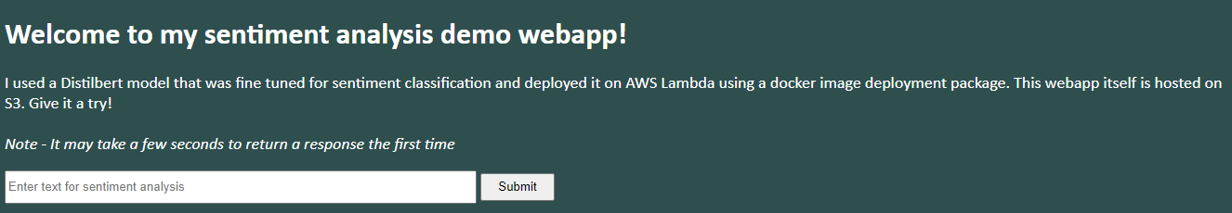

Serving real time insights from a machine learning model through a webapp
Note - Sentiment model predictions are highly skewed towards +/-1
Webapp Link
This model is from Hugging Face which has many other interesting state of the art models on NLP, computer vision, audio, etc that you can fine tune and deploy!

Slide 4
Why is this interesting?
Productizing an ML model is key to delivering value at scale.
Data science model is an important, but small piece of the whole pipeline. Familiarity with different parts of the pipeline helps one become more full stack data scientist.
It is fun!
Because of time constraints, I will give an overview of the steps. To get the most out of it, follow the instructions in this slide deck and let me know if you face issues!

Slide 5

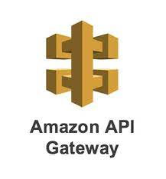


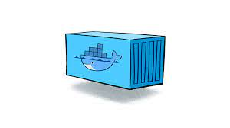

Architecture diagram - How does the information flow?
AWS
API response
API response
Lambda - Runs user code, Fully handles needed infrastructure
API request
API request
Container - Code + dependencies
ECR - Hosts Docker
Images
S3 (general file storage - for webpage stores index.html, CSS)
API gateway - Routes, logs API requests/responses

Slide 6
Getting started with AWS
Create a free AWS account. This account has root privileges.
Turn on Multi Factor Authentication
Create monthly budgets and billing alerts to avoid charges
Create IAM non-root accounts for regular use and giving access to other services
Install AWS Sam CLI automates most of the deployment - note the link includes pre-requisite steps listed above
Really indepth AWS course - https://learn.cantrill.io/p/aws-certified-solutions-architect-associate-saa-c03

Slide 7
Set up code
Use AWS Sam Init that has guided choices and ends with creating a starting folder.
References
https://docs.aws.amazon.com/serverless-application-model/latest/developerguide/using-sam-cli-init.html
https://www.youtube.com/watch?v=tL3-PqQvdF4

Slide 8
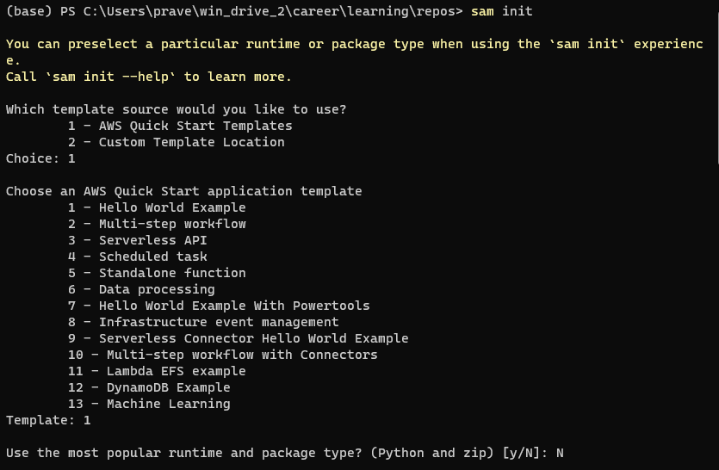
sam init guided choices to startup folder

Slide 9
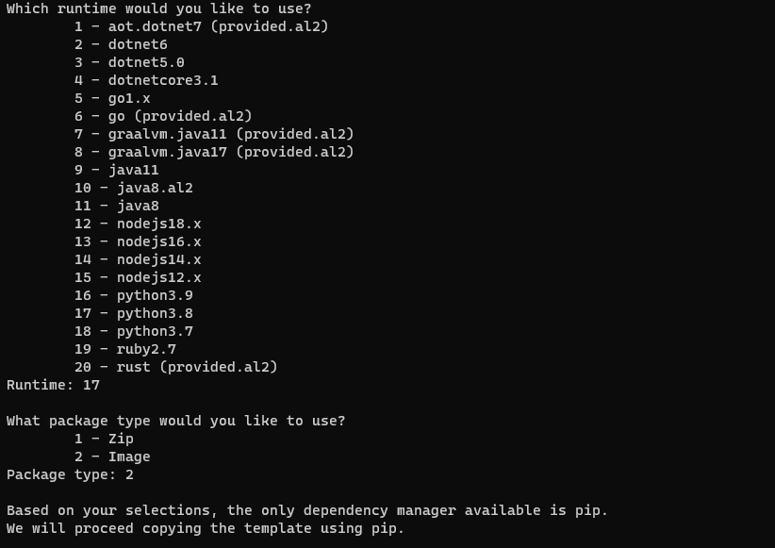
sam init guided choices to startup folder
https://docs.aws.amazon.com/serverless-application-model/latest/developerguide/using-sam-cli-init.html

Slide 10
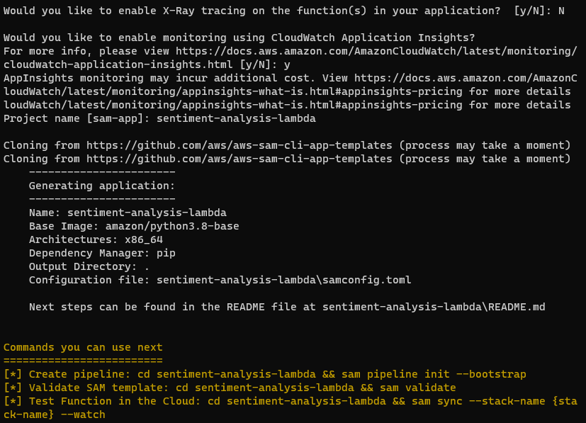
sam init guided choices to startup folder
https://docs.aws.amazon.com/serverless-application-model/latest/developerguide/using-sam-cli-init.html

Slide 11
After sam init
Modify following files (you can use my repo to see the modifications)
Template.yaml - template for creating AWS resources
App.py - has the lambda handler function and API
Requirements.py - python dependencies to install locally. Also, get installed in docker
Dockerfile - create docker container, copy model and download dependencies. Set Lambda handler as entry point function.
Create download_model.py - use this to download model from Hugging Face. Otherwise you can create your own
Use the reference below to make changes
References
https://github.com/praveen-taneja/sentiment-analysis-lambda - Let’s take a look at few of these especially app.py
https://docs.aws.amazon.com/serverless-application-model/latest/developerguide/using-sam-cli-init.html

Slide 12
Deployment
sam build -
Downloads, installs, organizes code dependencies.
Prepares lambda code and docker image
Adds everything to .aws-sam/.build folder
sam local start-api - sets up the API for local testing eg using Postman
sam deploy - creates infrastructure on AWS
At the end gives out the API URL that can be used to send API requests to the model (using postman or webapp)

Slide 13
Deployment
Different options to deploy model in AWS
What is AWS Lambda?
User provides the code for the function. AWS supplies the compute. It is serverless which means user doesn't have to manage the server (but of course server is there and is managed by AWS)
Users are charged only for how often the function is called and resources used when the function is run.
What is a docker container?

Slide 14
DIY
Clone the repo on your computer
Install AWS CLI

Slide 15
Webpage hosting on S3
Create an S3 bucket (add index.html, CSS files), enable static website hosting,
References
https://youtu.be/n5XFPLo4Bbw?t=3270
https://github.com/praveen-taneja/api-frontend - front end code used for the demo. Remember to replace API url in index.html

Slide 16
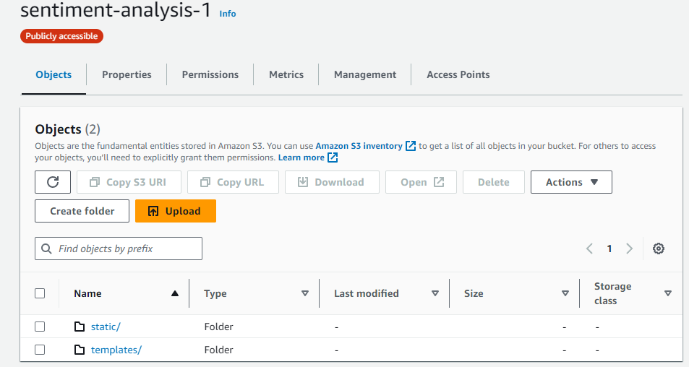
Webpage hosting on S3

Slide 17
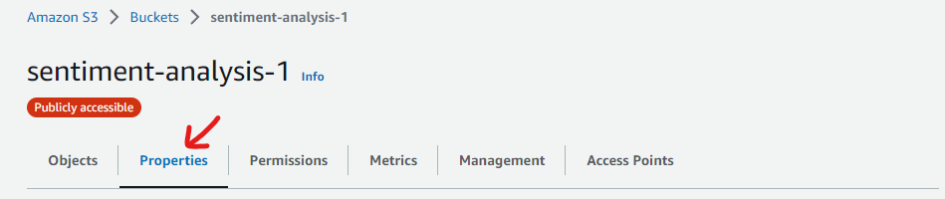
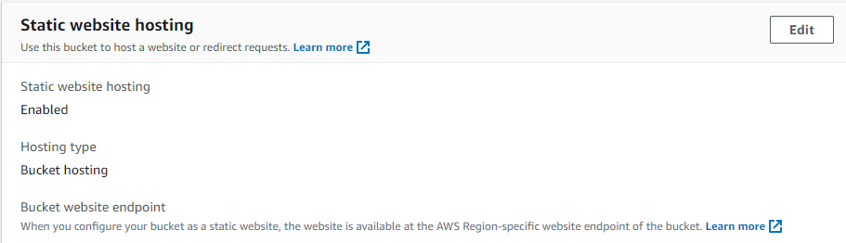
Webpage hosting on S3

Slide 18
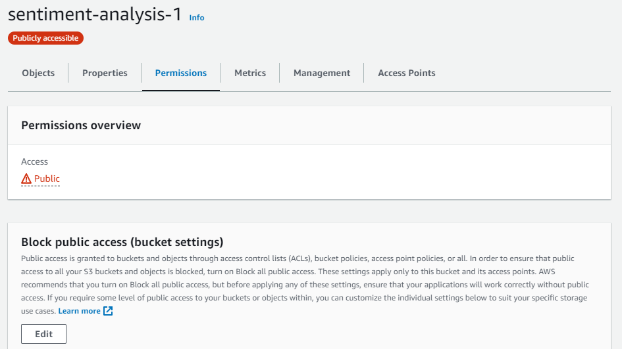
Webpage hosting on S3

Slide 19
Webpage hosting on S3

Slide 20
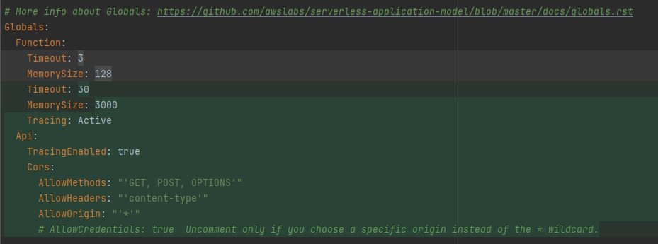
https://docs.aws.amazon.com/serverless-application-model/latest/developerguide/using-sam-cli-init.html

Slide 21
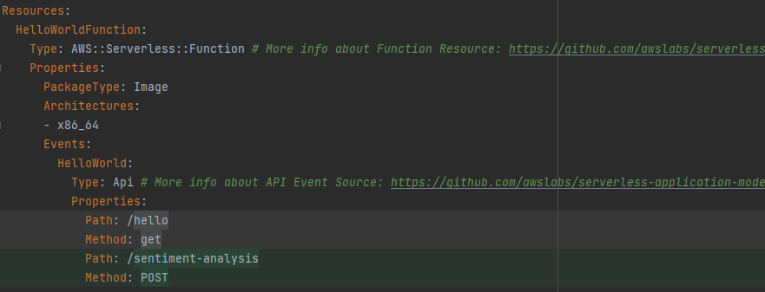

Slide 22
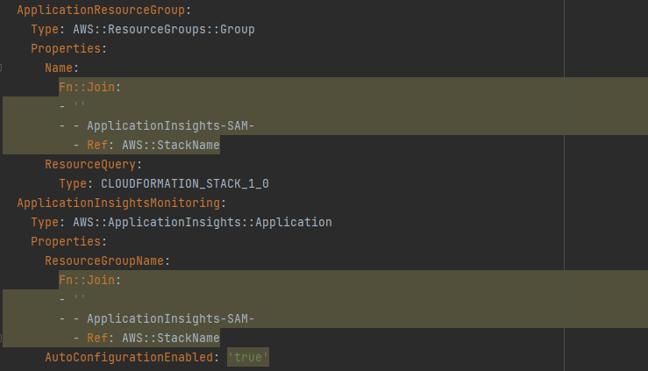

Slide 23
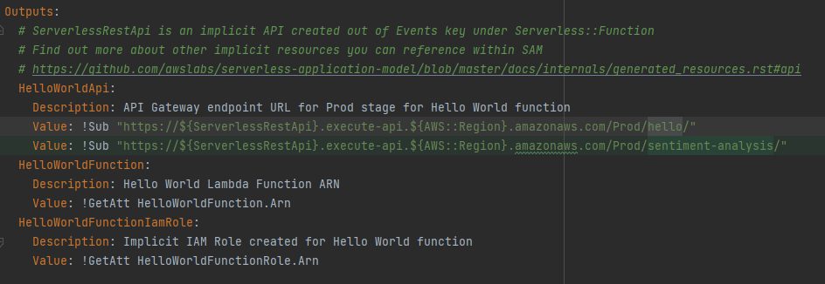

Slide 24
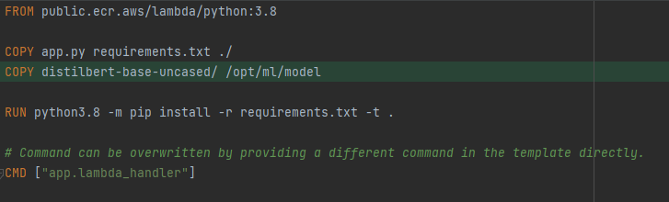
Make changes to Docker file

Slide 25
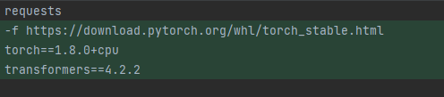
Changes to requirements.py

Slide 26
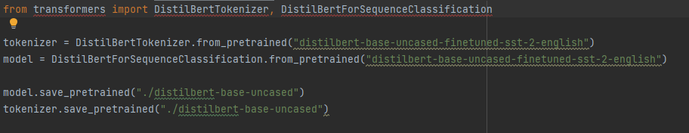
Add download_model.py

Slide 27
Make changes to app.py
Add model pipeline
Add lambda handler - API requests are passed to this function by Lambda
Add test_prediction() - to test lambda handler function without API
https://github.com/praveen-taneja/sentiment-analysis-lambda/blob/main/hello_world/app.py

Slide 28
Create conda env
conda create -n sentiment_analysis python=3.8
conda activate sentiment_analysis
conda install pip (if not automatically installed)
pip install -r requirements.txt
python download_model.py

Slide 29
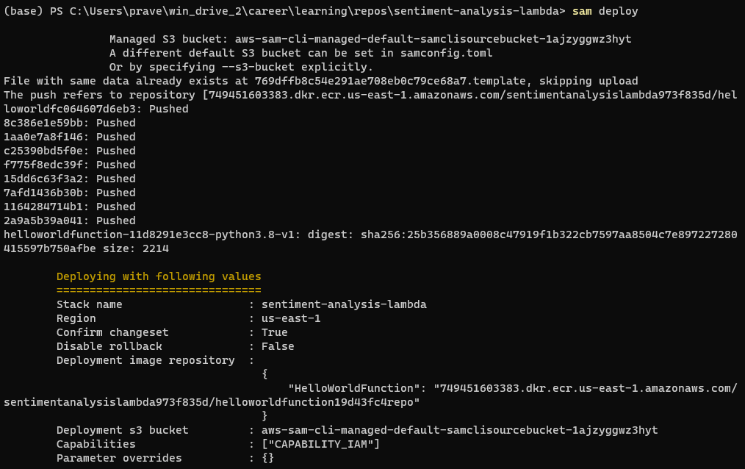
Sam deploy

Slide 30
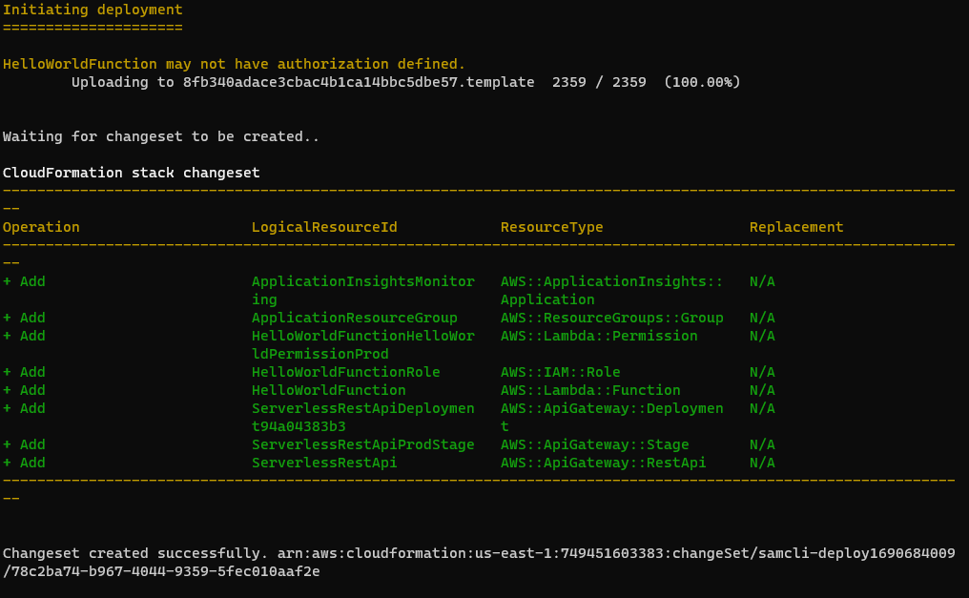
Sam deploy

Slide 31
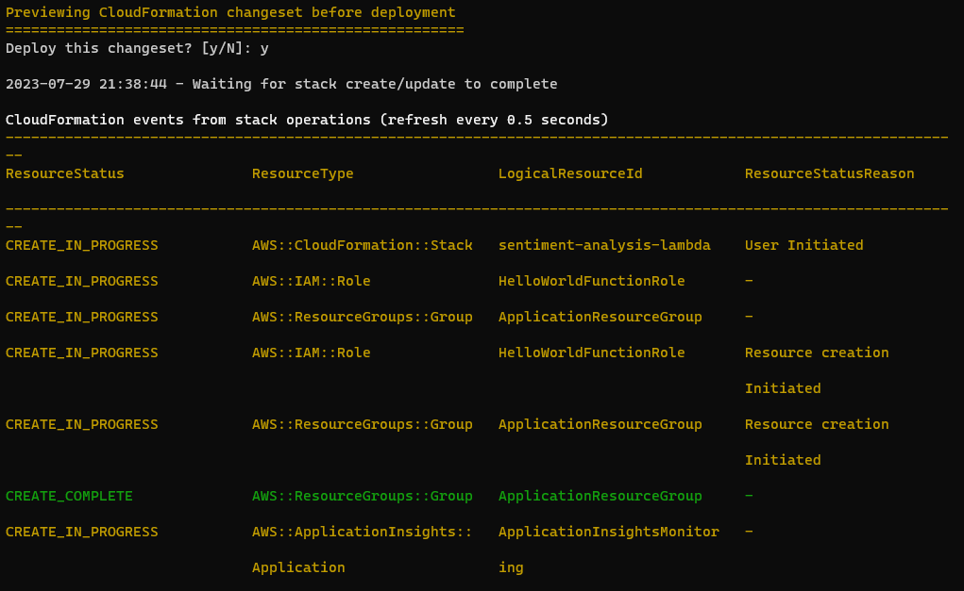
Sam deploy

Slide 32
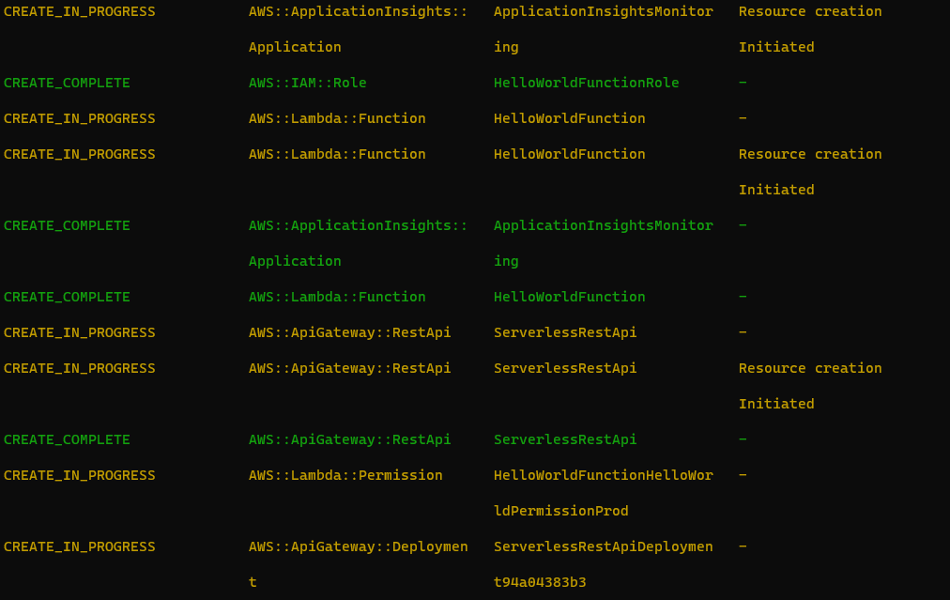
Sam deploy

Slide 33
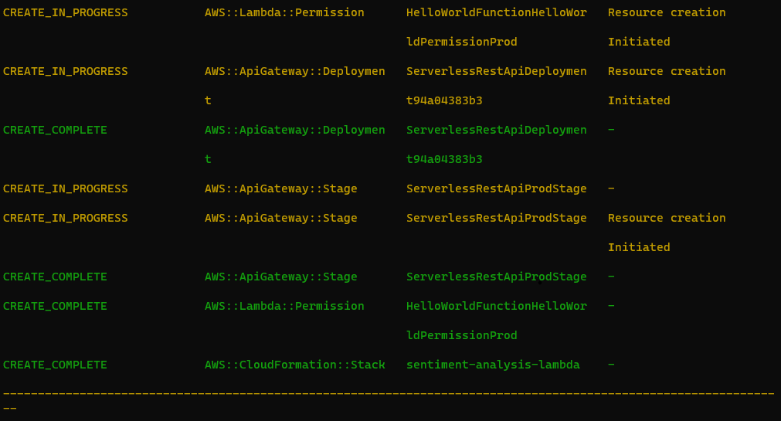
Sam deploy

Slide 34
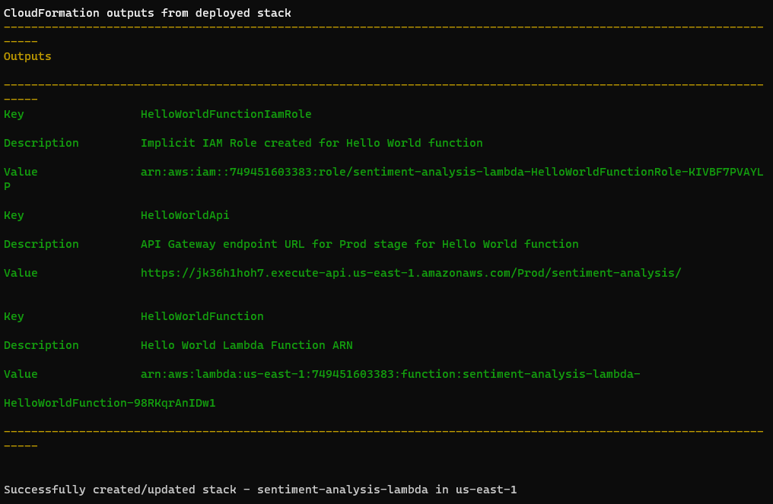
Sam deploy

